Slide 1
Text Summarization
Precision Précis
Kathan Bhavsar - AU2040170
Neel Buddhdev - AU2040176
Rushali Moteria - AU2040210
Twinkle Popat - AU2040216

Slide 2
Introduction and Problem Statement
Information available online has grown exponentially.
Summarization: Reducing a large body of text into a shorter version by capturing the key points and main ideas
Manual summarization: time-consuming and subjective
Automated approaches: more efficient and consistent
Problem Statement: The challenge lies in developing models that can accurately capture the most important information while avoiding redundancy or irrelevant content. This report will explore the application of an SVM model for text summarization.

Slide 3
Existing body of work
The approach in the paper, “Extractive Text Summarization using Neural Networks” is a fully data-driven approach that relies on neural networks for text summarization. Our model uses a algorithm that relies on feature engineering to identify important sentences for summarization.
The neural network approach uses a feedforward neural network to identify important sentences for summarization.
The neural network approach proposed in the paper is scalable and can produce summaries of arbitrarily sized documents.

Slide 4
OUR APPROACH
Training the SVM model:
Articles and reference summaries
Sentence Tokenization
Sentence Level Annotation
(Binary Array)
Count Vectoriser array for articles
Model Training
(SVM)

Slide 5
Initial Results (Using SVM model)
Count Vectorizer array and Binary array for the test data
The first array is Countvectorizer giving the frequency of the unique words. Second array is the Binary array where 1 represents that the sentence contains an entity word.
Predicted array generated by the SVM model:
This array is the array generated by the SVM model, where 1 represents that the sentence is of importance.

Slide 6
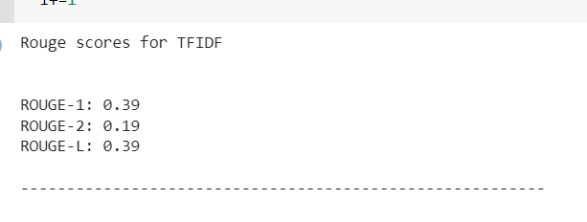
Initial Results (Using TF-IDF)
ROUGE scores for comparing the similarity between the summary generated by TF-IDF and the reference summary.

Slide 7
Role of each group member and Future work
Kathan Bhavsar:
Code and Research
Twinkle Popat:
Report and Research
Rushali Moteria:
Report and Research
Neel Buddhdev:
Code and Research
Future Work:
Solving the problem for SVM model and also implement sentence level annotation using Topic Modeling (LDA) and Sentence Similarity. We will check the accuracy by using different kernels.

Slide 8
References
"NLP based Machine Learning Approaches for Text Summarization," 2020 Fourth International Conference on Computing Methodologies and Communication (ICCMC)
https://ieeexplore.ieee.org/abstract/document/9076358
S. Zaware, D. Patadiya, A. Gaikwad, S. Gulhane and A. Thakare, "Text Summarization using TF-IDF and Textrank algorithm," 2021 5th International Conference on Trends in Electronics and Informatics (ICOEI)
https://ieeexplore.ieee.org/document/9453071
A. W. Palliyali, M. A. Al-Khalifa, S. Farooq, J. Abinahed, A. Al-Ansari and A. Jaoua, "Comparative Study of Extractive Text Summarization Techniques," 2021 IEEE/ACS 18th International Conference on Computer Systems and Applications (AICCSA)
https://ieeexplore.ieee.org/document/9686867
N. Andhale and L. A. Bewoor, "An overview of Text Summarization techniques," 2016 International Conference on Computing Communication Control and automation (ICCUBEA)
https://ieeexplore.ieee.org/abstract/document/7860024

